Slide 1


Energy Efficiency Prediction using Multioutput Regression Models
Data Mining Project

Slide 2
Problem Statement:
With increasing population and growing energy demand, efficient use of energy is one of the most cost-effective ways to save money, lower green house gas emissions and helps in improving well being of the building occupants or homeowners.
Heating load is the amount of heat energy needed to keep the interior of a building warm during colder periods. Cooling load is the amount of energy required to cool a building and maintain a comfortable temperature during warmer periods.
This project will give the basic idea of studying heating and cooling loads of different types of buildings with various parameters. The load calculations will have an impact on energy efficiency.

Slide 3
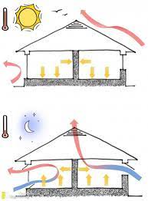
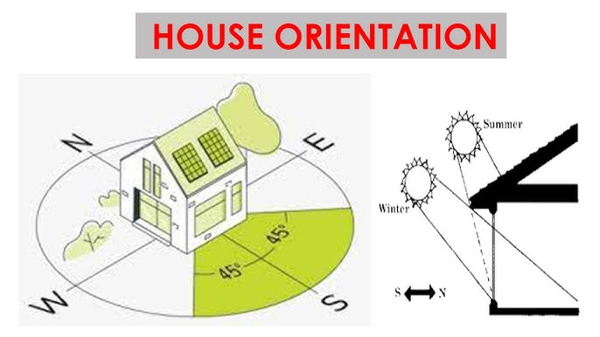
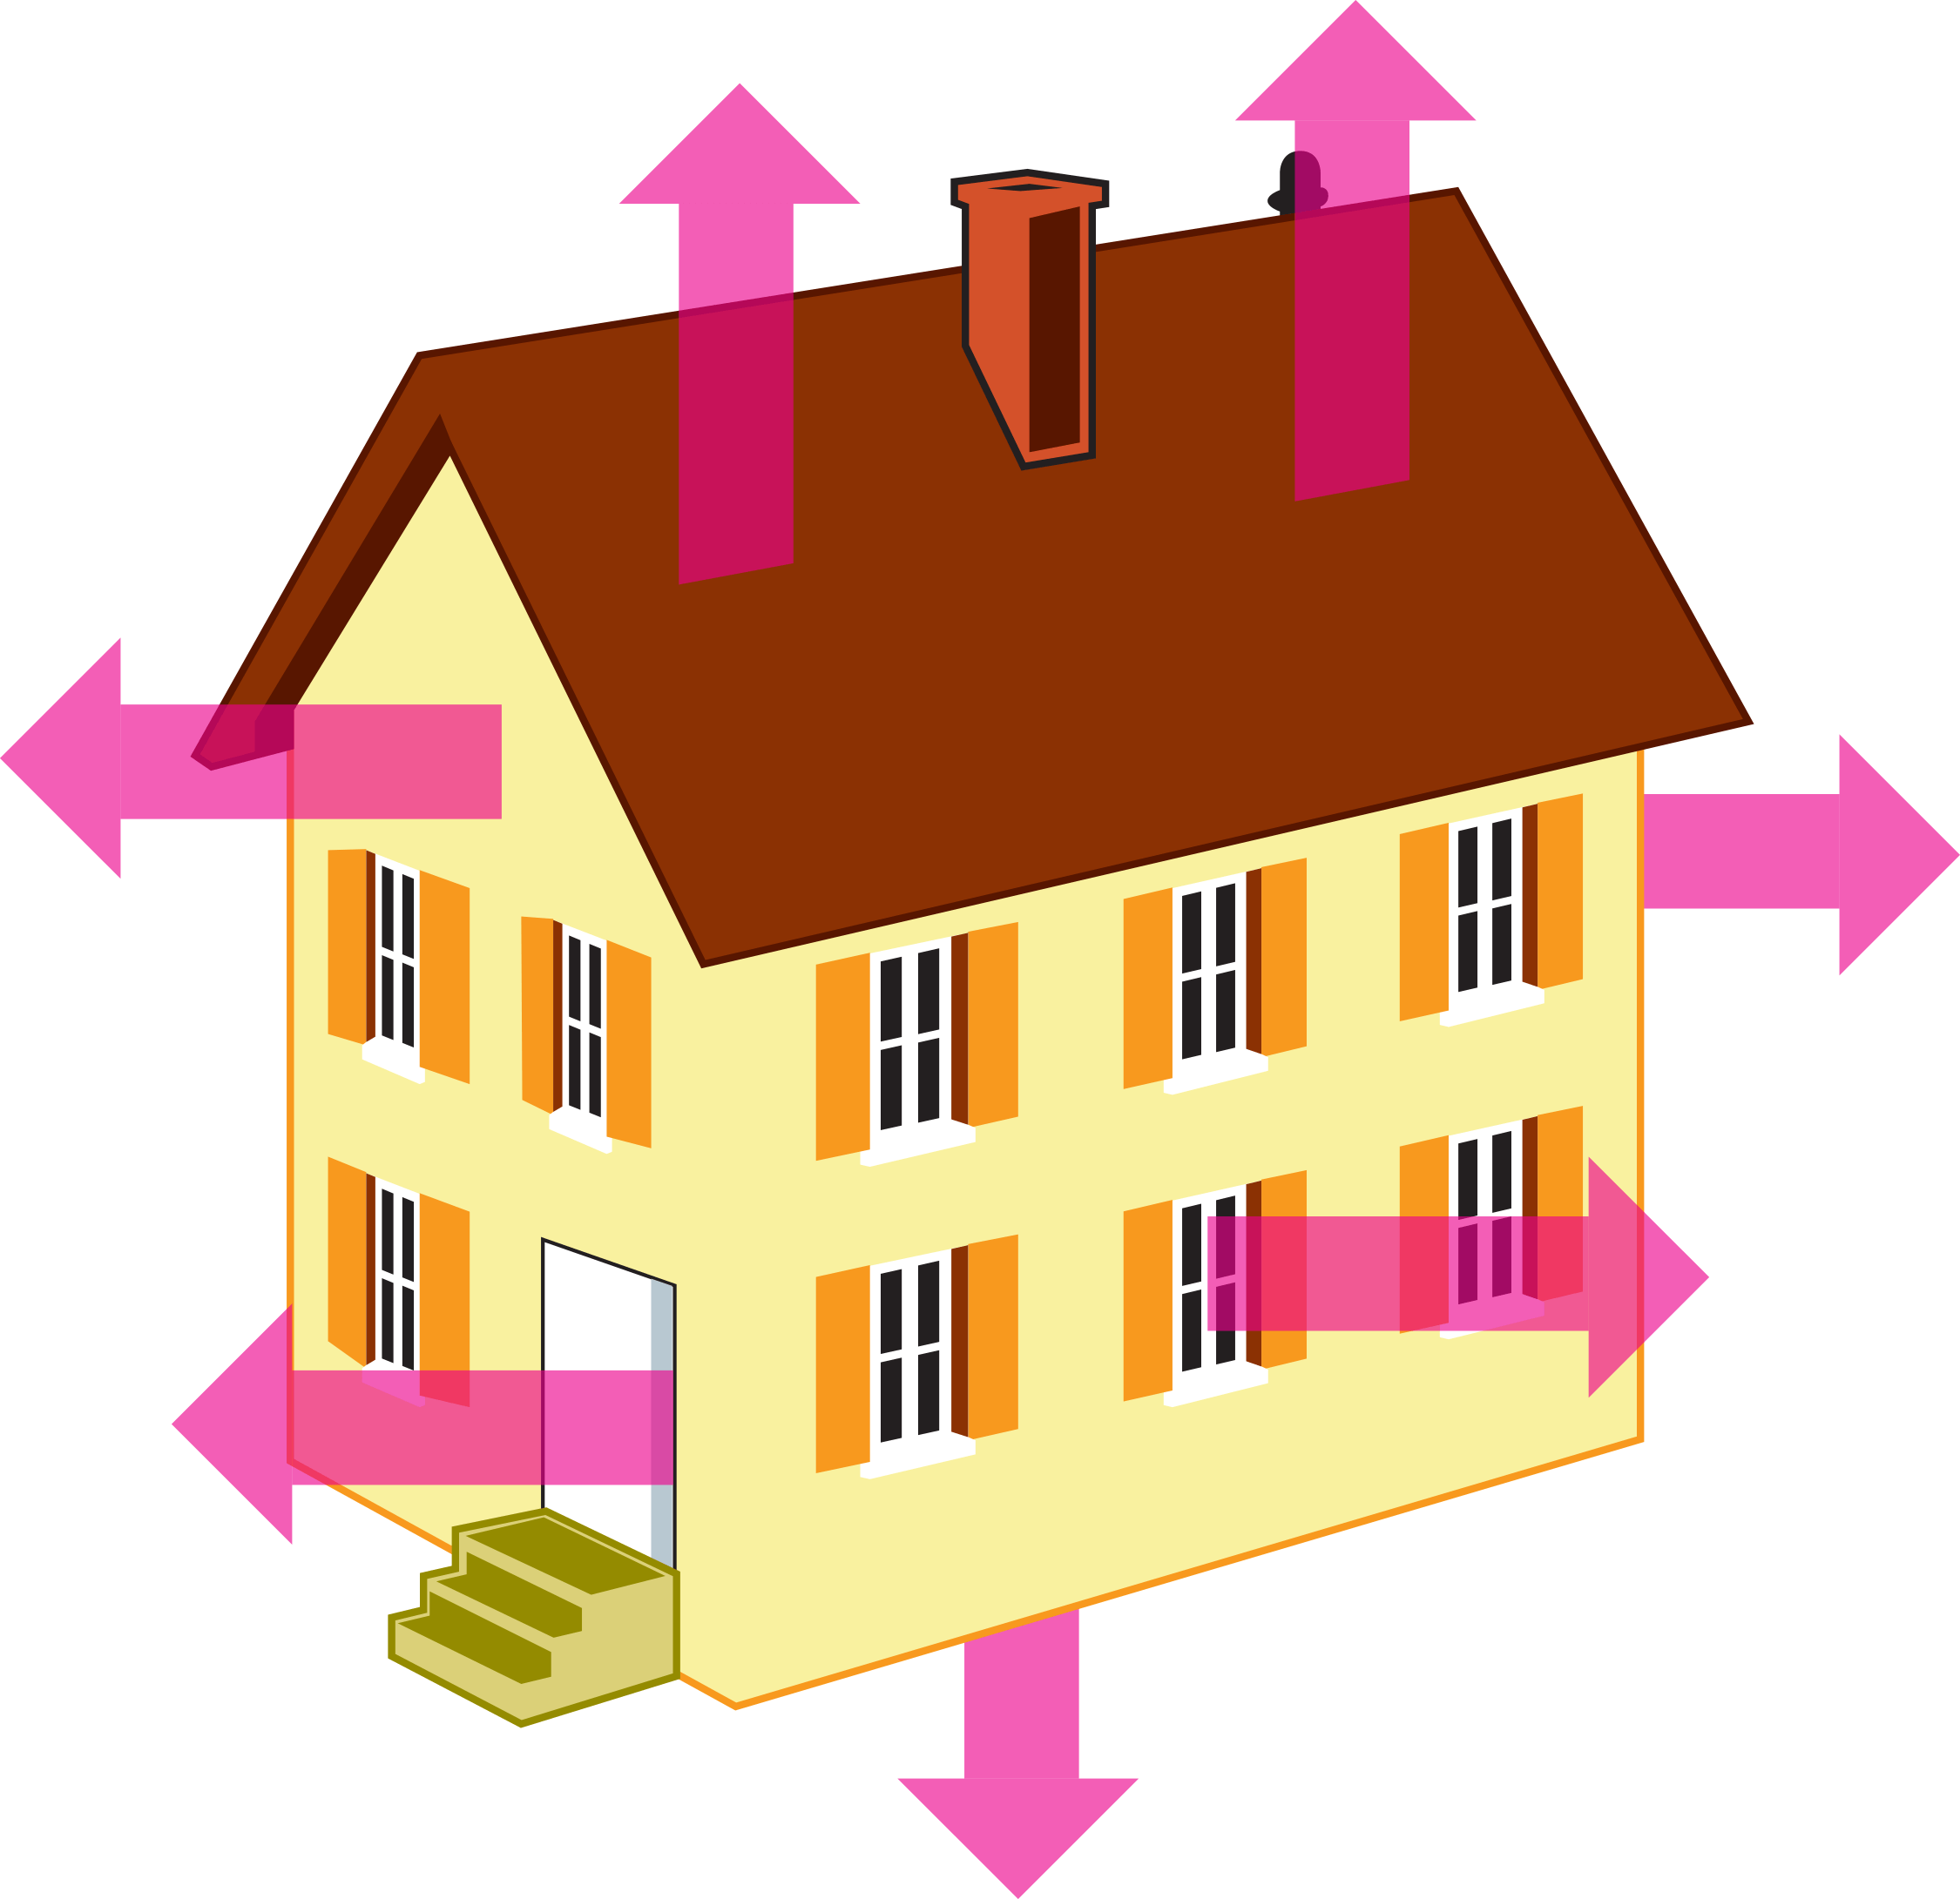

Inputs/Attributes
Relative Compactness
Model
Surface Area
Outputs
Wall Area
Heating Load
Roof Area
Overall Height
Glazing Area
Cooling Load
Orientation
Glazing Area Distribution
Data Mining Steps

Slide 4
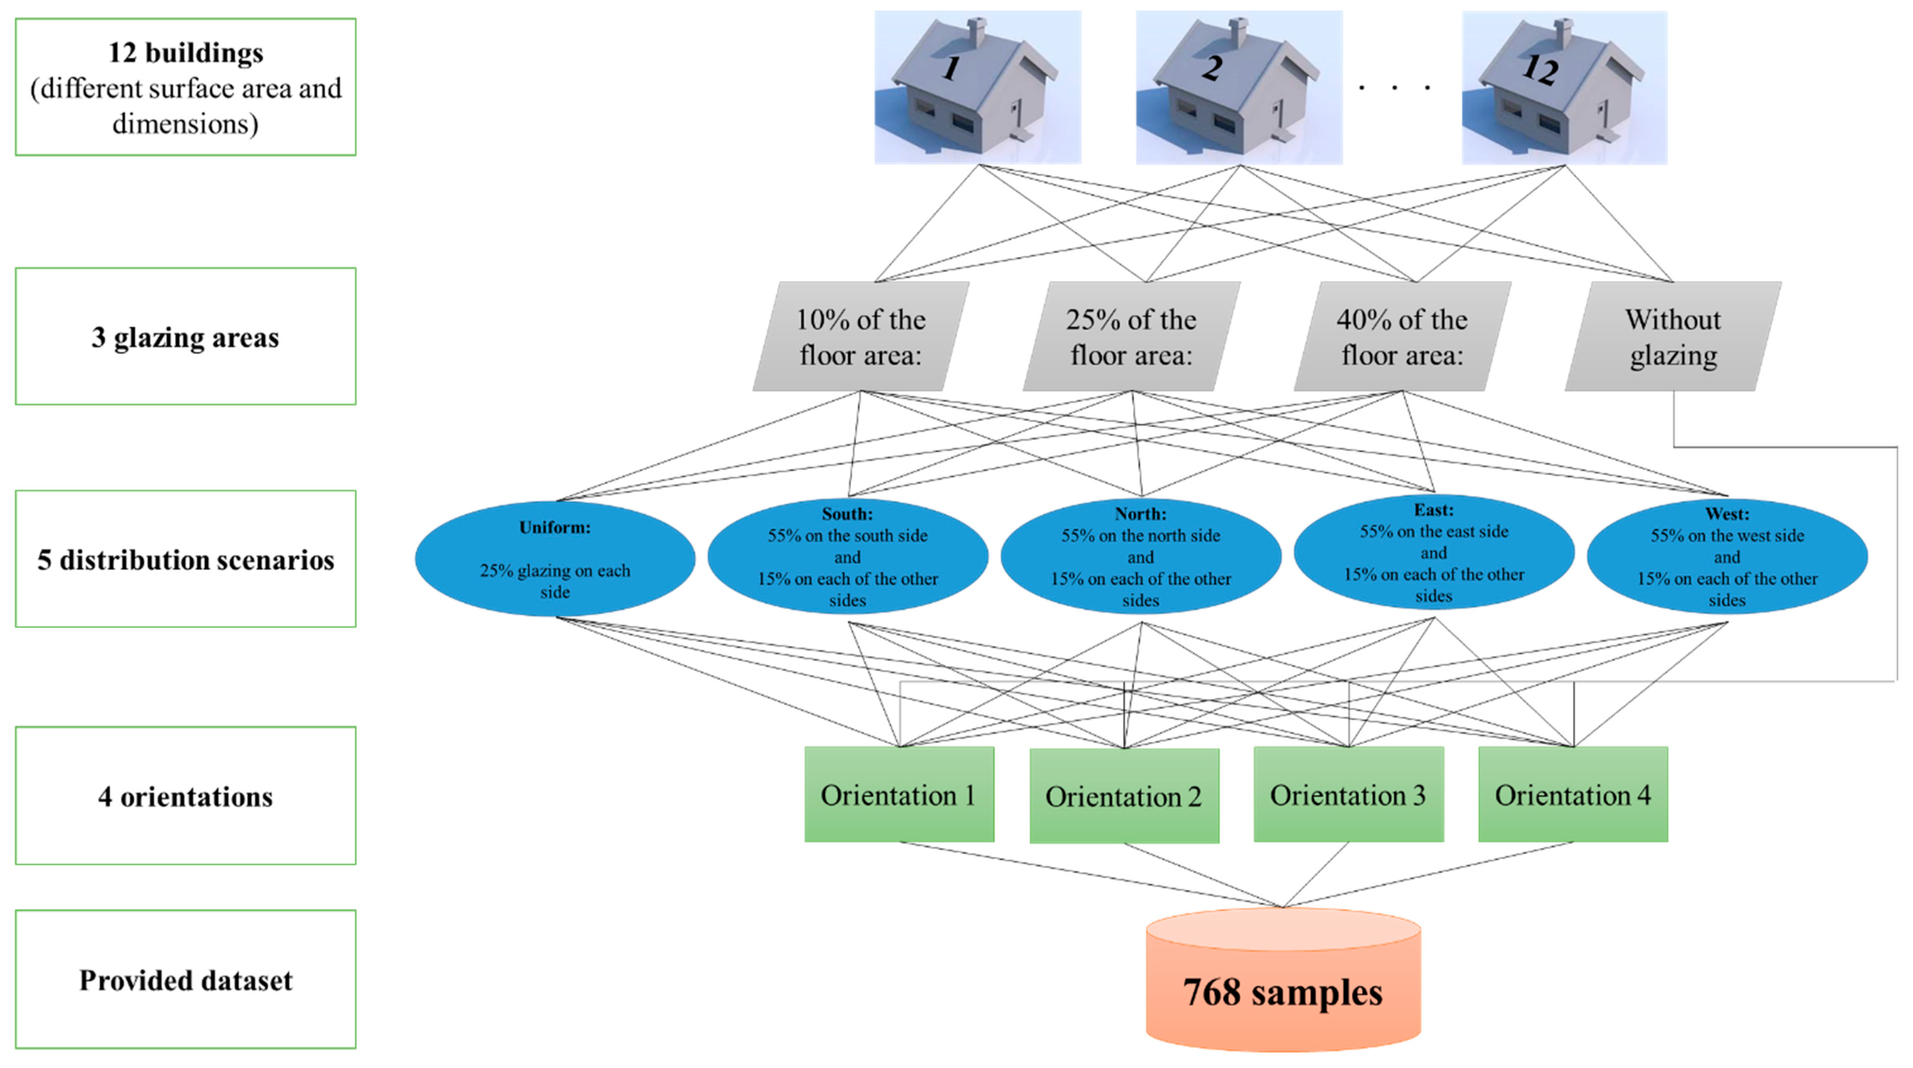
Dataset

Slide 5
Related Work:
Till now separate regression models were developed for each target variable to be predicted i.e., Single-Output.
Techniques such as logistic regression, random forest, decision tree and KNN regressor models were used.
Time consuming to compare the results for performance evaluation because for the same set of input parameters the model is trained twice for each output.

Slide 6
Proposed Work:
Study the heating and cooling loads requirements of residential buildings with various parameters and perform prediction using regression analysis.
Model the train data with regression algorithms using standard parameters that support multiple outputs directly such as logistic , decision tree, random forest and k-nearest neighbors to replace repetitive work and predict the outputs simultaneously.
Using Multi output support vector regressor algorithm to extend single-output models.
Fine tune the models using GridSearchCV.
Evaluate the model’s performance on the test data.
Compare the performance of the different algorithms used to predict heating and cooling loads in buildings.

Slide 7
Evaluation:
Measure R-squared, Mean Square Error, Root Mean Square Error and Mean Absolute Error to compare the performance of prediction models.
Timeline:
Week1: Read the data and do exploratory data analysis
Week2: Data Preprocessing
Week3: Data Modeling and Evaluation
Week4: Results and project report submission

Slide 8
Checkpoints:
Data collection
Data understanding- data type and size
Detect missing data
Check for outliers using boxplots
Data visualization to identify patterns by exploring distributions
Find correlations between independent variables to detect multicollinearity
Transform the data if needed- Scaling
Split the data into training and test sets(80/20)
Model the data using linear regression, Knn, decision tree, random forest and multioutput regressor
Compare the scores of the five algorithms.
Choose the best model and fine tune it for optimal performance.

Slide 9
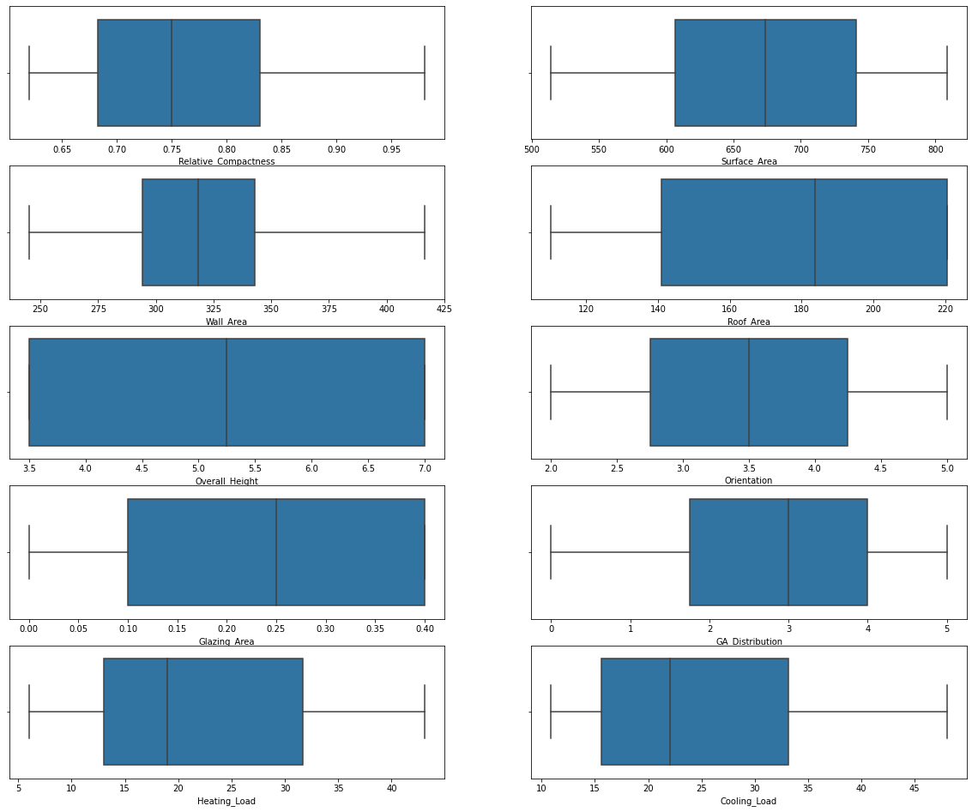
Box Plot
There are no outliers present in the dataset

Slide 10
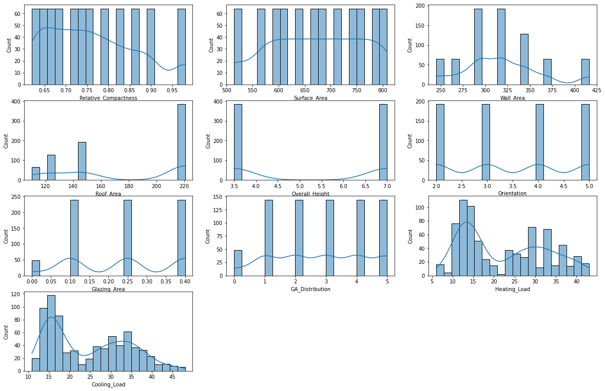
Histogram
Data does not have normal distribution

Slide 11
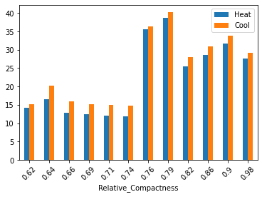
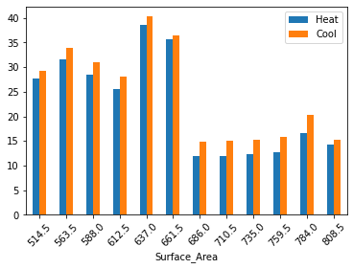
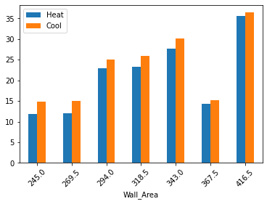
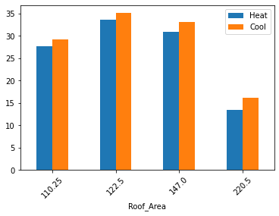
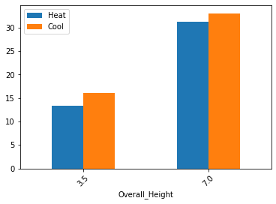
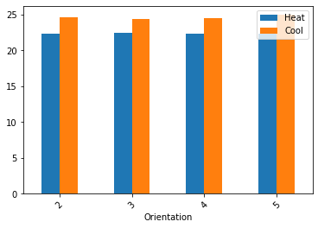
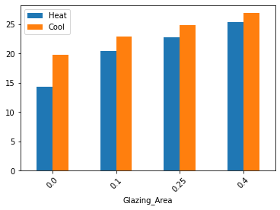
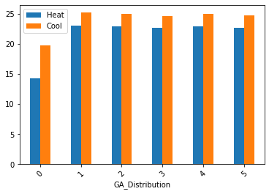
Heating load and Cooling Load Distribution
On average the cooling load is always higher than heating load for each feature.

Slide 12


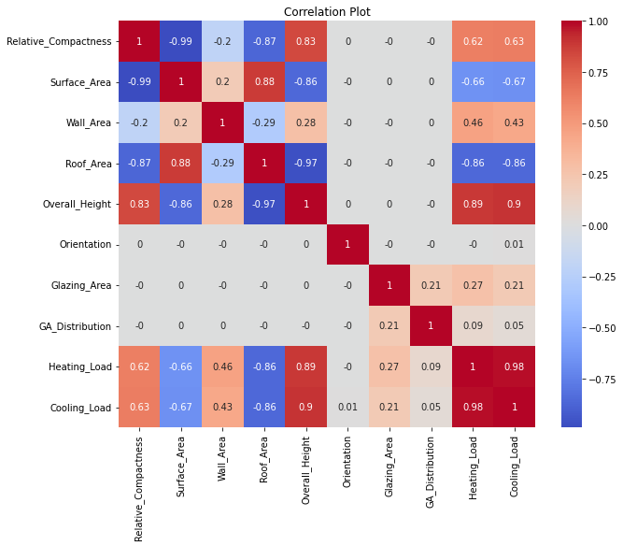
Correlation Matrix
Top Correlations Pairs:
Heating_Load Cooling_Load 0.98
Surface_Area Roof_Area 0.88
Relative_Compactness Overall_Height 0.83
The high correlation coefficient between the above pair of features shows existence of multicollinearity.
Strong correlation between the targets heating and cooling loads ensures better predictive performance by using multi-output regressor.

Slide 13
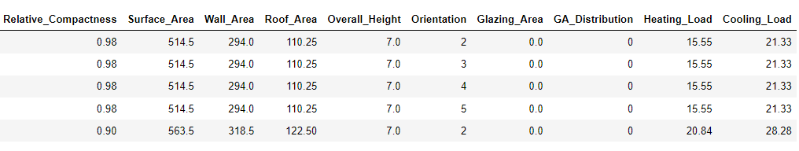
Dataset
Since the magnitudes of surface area, wall area and roof area is large compared to other features , I performed scaling with sklearn’s minmax scaler after splitting the data.
Build a model using train set using the 5 proposed regression algorithms.
Calculated scores like R2, MSE,RMSE and MAE to compare the predictive skill of each model.
Compared raw data and scaled data results.
A good regression model will have - R2 ≥ 0.9, MSE ,RMSE and MAE values closer to 0 i.e. the lower the value, the better the performance of the model.

Slide 14
Comparison of trainset data model performance
Raw Data
Minmax Scaler
Model | R2 | MSE | RMSE | MAE
Linear Regression | 0.897 | 9.888 | 3.145 | 2.234
Knn | 0.968 | 3.083 | 1.756 | 1.253
Decision Tree | 1.000 | 0.000 | 0.000 | 0.000
Random Forest | 0.997 | 0.300 | 0.548 | 0.282
Multioutput SVR | 0.994 | 0.562 | 0.750 | 0.376
Model | R2 | MSE | RMSE | MAE
Linear Regression | 0.897 | 9.895 | 3.146 | 2.235
Knn | 0.929 | 6.901 | 2.627 | 1.791
Decision Tree | 1.000 | 0.000 | 0.000 | 0.000
Random Forest | 0.997 | 0.305 | 0.552 | 0.287
Multioutput SVR | 0.910 | 8.625 | 2.937 | 1.821
Observations:
Scaling has no impact on model performance for tree-based algorithms (Decision tree and Random forest) since they are not distance based.
No change in performance of linear regressor model and knn regressor model’s performance is better with raw data than with the scaled data.
Multioutput regressor model used with support vector regressor model performed well on raw data than scaled data.
Since the dataset contains both numerical variables and categorically encoded data, scaling would often confuse the model.

Slide 15
Comparison of Single-output and Multi-output Models
Model | R2_MO | R2_SO_HL | R2_SO_CL
Linear Regression | 0.897 | 0.918 | 0.885
Knn | 0.968 | 0.946 | 0.927
Decision Tree | 1.000 | 1.000 | 1.000
Random Forest | 0.997 | 0.999 | 0.995
Multioutput SVR | 0.994 | None | None
SVR | Not supported | 0.930 | 0.893
Train data
Multi-output models did well than the single-output models based on the R2 scores.
Model | R2_MO | R2_SO_HL | R2_SO_CL
Linear Regression | 0.896 | 0.910 | 0.890
Knn | 0.921 | 0.904 | 0.890
Decision Tree | 0.977 | 0.997 | 0.950
Random Forest | 0.981 | 0.998 | 0.962
Multioutput SVR | 0.984 | None | None
SVR | Not supported | 0.911 | 0.887
Test data

Slide 16
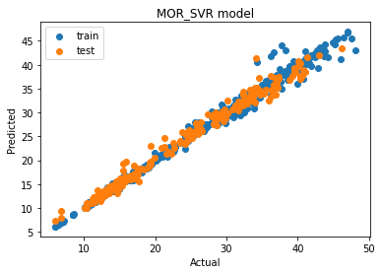
Model performance on train and test data
Model | R2 | MSE | RMSE | MAE
Linear Regression | 0.897 | 9.888 | 3.145 | 2.234
Knn | 0.968 | 3.083 | 1.756 | 1.253
Decision Tree | 1.000 | 0.000 | 0.000 | 0.000
Random Forest | 0.997 | 0.300 | 0.548 | 0.282
Multioutput SVR | 0.994 | 0.562 | 0.750 | 0.376
Conclusions:
The models have been evaluated on the test set.
Since scaling did not have any effect on the performance, raw data is used.
Decision tree model outperforms all other models on train set. Random Forest and Multi-output SVR did well too. The MSE, RMSE and MAE scores of these 3 models are closer to 0.
Multi-output SVR has the best test score with 0.984 (R2 in the above table) with better MSE,RMSE and MAE values which indicates a good model. The scores of Decision tree and Random Forest models are also good.
Train data
Model | R2 | MSE | RMSE | MAE
Linear Regression | 0.896 | 9.124 | 3.021 | 2.157
Knn | 0.921 | 7.003 | 2.646 | 1.925
Decision Tree | 0.977 | 1.933 | 1.390 | 0.629
Random Forest | 0.981 | 1.585 | 1.259 | 0.659
Multioutput SVR | 0.984 | 1.417 | 1.190 | 0.791
Test data

Slide 17
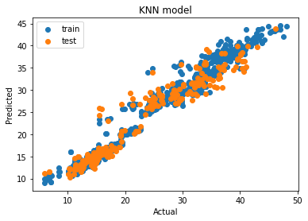
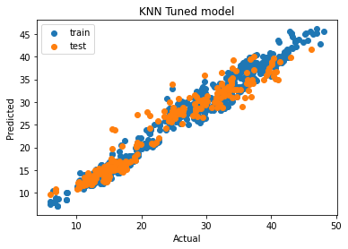
Hyperparameter tuning
Did not improve Linear Regression model
Improved the model performance of KNN regressor.
KNN Regressor | R2_train | R2_test | MSE | RMSE | MAE
Base Model | 0.968 | 0.921 | 7.003 | 2.646 | 1.925
Tuned Model | 0.975 | 0.934 | 5.839 | 2.416 | 1.787

Slide 18
Conclusions
Multi-output models performed better than single-output models.
Mult-output SVR , Decision tree and Random Forest performed better than Linear regression and KNN model.
Tuning KNN model with GridSearchCV improved the model's performance.
Future Work
Increase the quantity of data samples and perform the study with Deep learning models and compare with Machine learning models results from this study.
THANK YOU

